Slide 1
Accelerate AI transformation with Microsoft 365 Copilot + agents
Last update: December 2025

Slide 2
PARTNER GUIDANCE
This deck is designed for customization. It provides an introduction to Microsoft 365 Copilot Business but does not include the full pitch. Please incorporate additional product-focused slides from the master pitch deck and tailor the content to align with your customers’ needs.
Microsoft 365 Copilot Customer Pitch Deck
Notes:
https://microsoftpartners.microsoft.com/downloads?filename=AI-Business-Solutions-for-Partners/Go-to-market/Copilot-and-Agents-at-Work/Others/Microsoft%20365%20Copilot%20customer%20pitch%20deck/Microsoft-Copilot-customer-deck.pptx

Slide 3
The small business reality…
53%
45%
80%
Say that their employees are currently bringing their own AI tools to work (BYOAI)²
Say they don’t have enough time or energy to keep up with work¹
Say that expanding team capacity through digital labor is a top priority in the next 12-18 months¹
¹ Source: 2025 Work Trend Index Annual Report
² Source: 2025 Work Trend Index Annual Report

Slide 4













The most secure AI solution for your business
More value at a price designed for small and medium-sized businesses
Secure AI Business Solutions
Best-in-class productivity
AI built for work
Enterprise-grade security
+ more
Microsoft 365 Business Premium
Microsoft 365 Copilot Business
Microsoft Purview Suite for Business Premium
Notes:
We’re introducing a new bundled offer that combines AI assistance from Microsoft 365 Copilot and advanced data protection from Microsoft Purview Suite with our Microsoft 365 Business Premium plans.
​
These bundles are designed to simplify your purchase – get familiar productivity apps plus AI capabilities built-in at, all at a lower price point than purchasing separately.

Slide 5
Business impact of using Microsoft 365 Copilot
up to
up to
up to
6%
20%
25%
increase in net revenue
reduction in operating costs
acceleration in new-hire onboarding
Source: Forrester Research: Total Economic Impact of Microsoft 365 Copilot for SMB, October 2024
Notes:
We heard feedback from customers that Copilot Chat lagged in quality and performance vs. ChatGPT
In response, over the last few months we’ve made significant enhancements in terms of performance, quality and model innovation.
We’ve rearchitected our underlying orchestration engine and the tech transfer process with Open AI.
This includes eliminating unnecessary processing steps and improving response times
We’ve also streamlined tool integration and consolidated reasoning into a shared base prompt.
The benefit to users is faster, higher quality and more consistent responses.
We also recently announced our commitment to incorporate the latest models from Open AI within 30 days. This started with simultaneously shipping GPT-5 on the same day as Open AI.
And, just last month we announced that we are bringing other models like Anthropic’s Claude models into Copilot for specific use cases

Slide 6

Business impact of using Microsoft 365 Copilot
Copilot Chat
Secure web-grounded AI chat & agents
AI-powered Create (standard access¹,
limited functionality)
Reason over open files in Microsoft 365 apps²
Pay as you go custom agents grounded in your data
GPT-5 Standard access¹
Microsoft 365
Copilot Business
Chat
Work-grounded
AI-powered Search
AI-powered Notebooks
AI-powered Create (priority access¹, full functionality)
GPT-5 Priority access¹
Copilot in Microsoft 365 apps
Advanced skills and in-app editing
AI built for work
Comprehensive agent access
$21
Pre-built Microsoft agents
Analyst & Researcher advanced reasoning agents
Custom agents grounded in your data³
(up to 300 seats)
Advanced Mgmt. & Analytics
¹ Learn about standard and priority access here. 2. Available in Word, Excel, PowerPoint, Outlook, and OneNote. 3. Applies to assistive agents built by you on the Microsoft 365 Copilot agent platform deployed on Microsoft 365 surfaces

Slide 7



Why Microsoft 365 Copilot?
AI built for work
Get more value with one simplified solution
Run your business with confidence
Built-in security you can trust

Slide 8
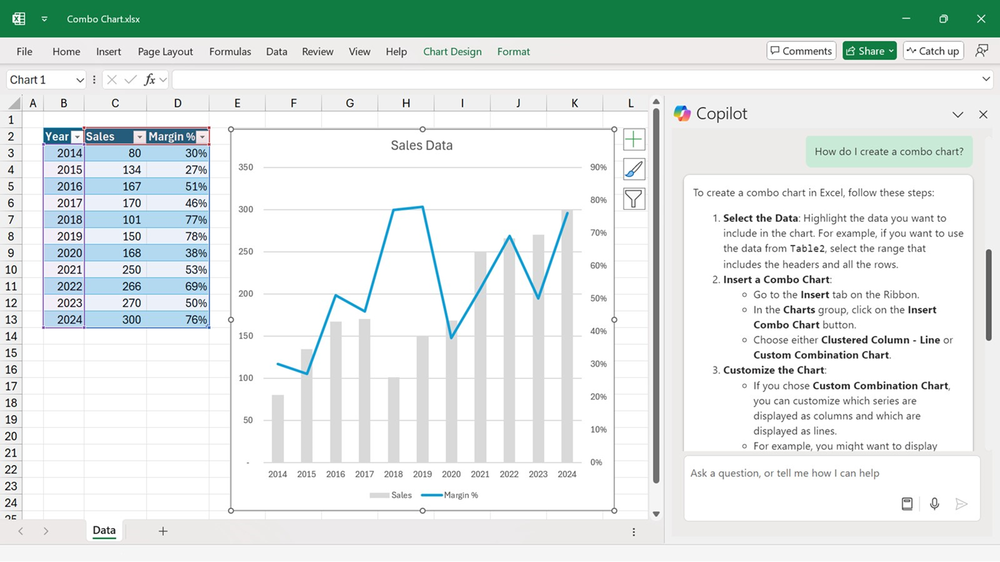
Get more value with one simplified solution
Single solution
One AI solution that works across your business and is included with your Microsoft 365 Business plan
Connected experience
Copilot works across familiar apps like Teams, Outlook, Word, Excel and PowerPoint, no context-switching required
Unified interface
The Copilot app unifies chat, search, apps and agents in a single, easy-to-navigate experience
Microsoft 365 Copilot helps you save time and work smarter without extra steps or complexity

Slide 9
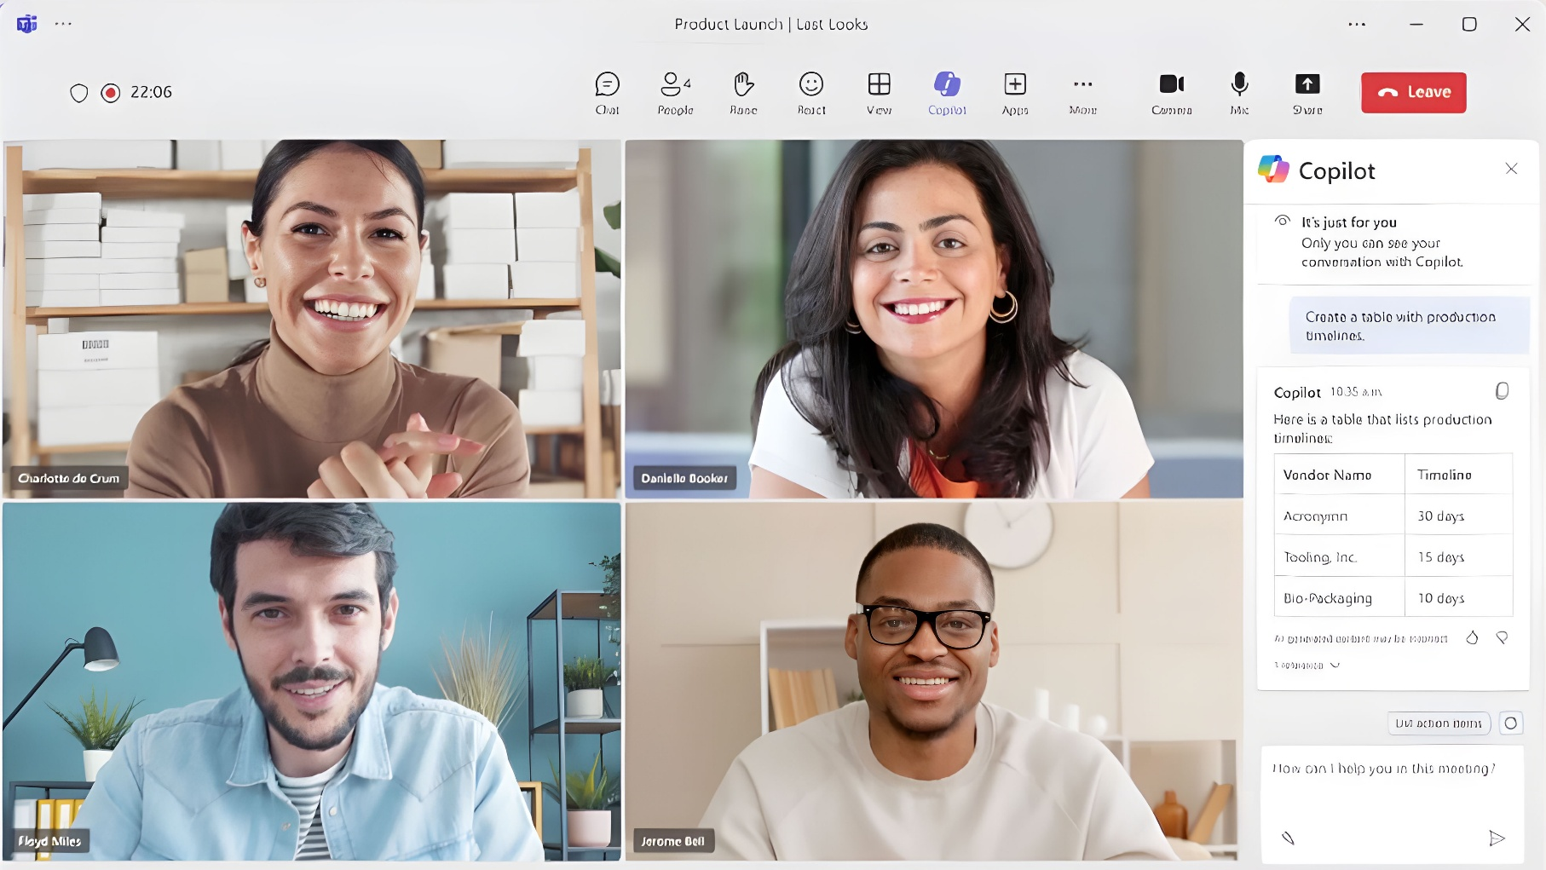
Run your business with confidence
Relevant context
Copilot is grounded on your work data across calendars, emails, chats, documents and meetings to improve relevance and accuracy
Ability to customize
Add your own data and build your own custom agents with minimal coding experience required
Role-based solutions
Get tailored AI experiences across various roles like Sales, HR, and Marketing
Microsoft 365 Copilot helps you run your business more efficiently

Slide 10
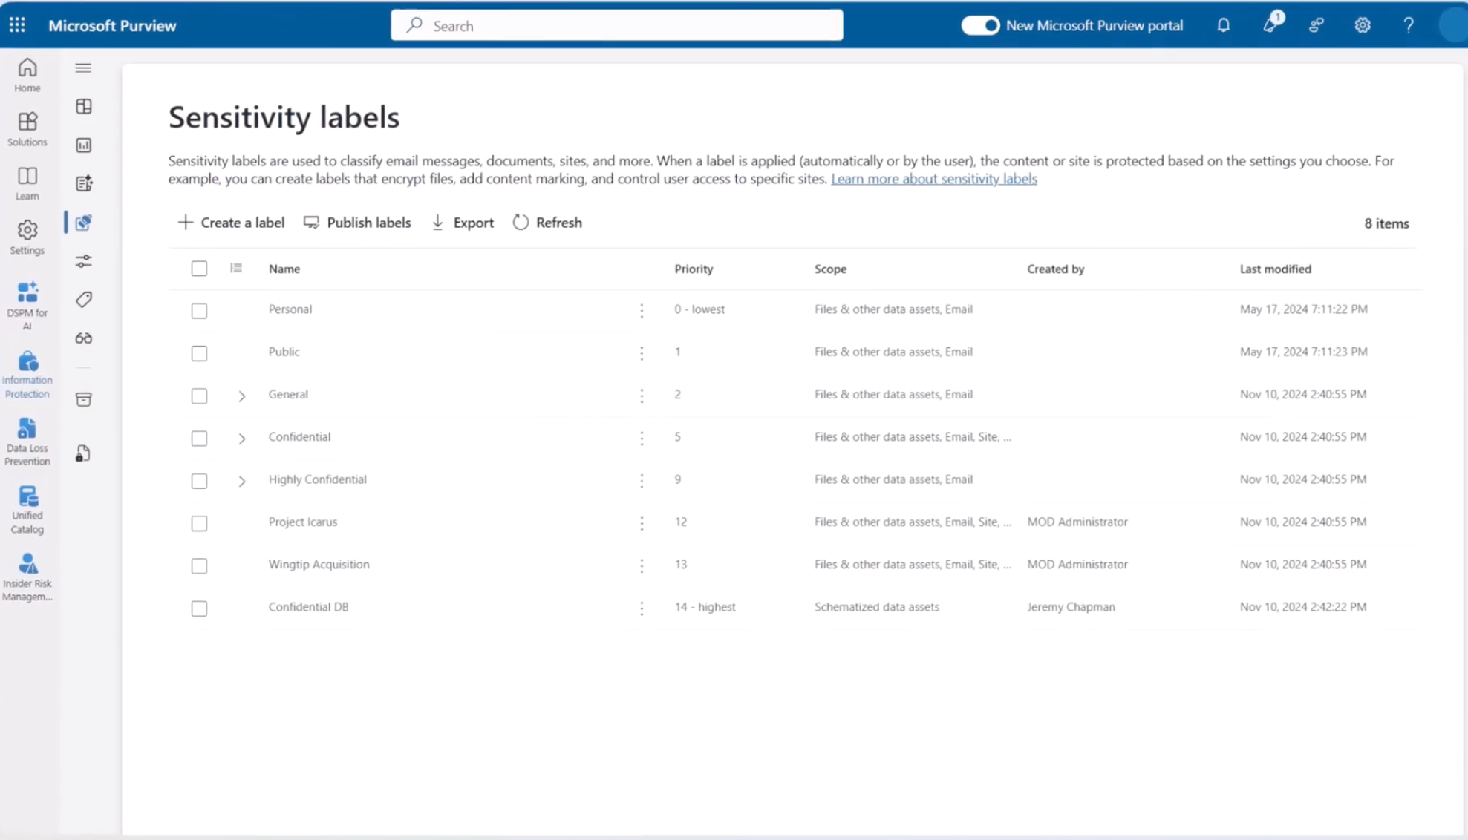
Built-in security you can trust
Protect sensitive data
Copilot follows your existing security, privacy, and compliance settings
Allow your data to stay with you
Only surfaces what users have permission to access; never used to train foundation models
Adopt AI safely
Reduce oversharing and keep your business data governed and protected
Microsoft 365 Copilot is built on Microsoft’s trusted cloud, so your business data stays safe and private

Slide 11



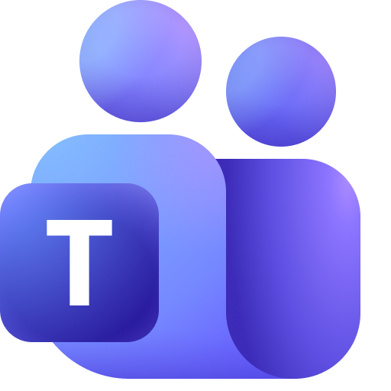


Where Copilot wows
Get proactive
overviews of your day
Analyze
budget spend
Prepare for
a customer meeting
Create
strategy papers
    Copilot Chat
    Analyst
    Researcher
    Researcher
Create
interview guides
Never take meeting
notes again
    Researcher
    Copilot in
    Teams Meetings
Catch up on
missed meetings
Quickly
find content
Be prepared
for every meeting
Quickly onboard onto
new roles or projects
    Copilot in
    Teams Meetings
    Copilot Search
    Copilot in
    Teams Meetings
    Notebooks
Notes:
We are excited and optimistic about where we’re headed, I want to take a moment to reflect on just a few scenarios where Copilot already shines.
Whether that’s drafting a whitepaper in Word
Creating an interview guide with Researcher
Analyzing data for you in Excel ​or analyzing spend with Analyst
Creating a presentation in .ppt ​
Summarizing emails in Outlook ​or sending meeting recaps ​
Copilot is helping companies save time and money every day.
Let’s take a closer look at these capabilities.

Slide 12

Microsoft 365 Business + Copilot Bundles
New!
New!
New SKUs combine Microsoft 365 Business and Copilot for Business to create a simple more streamline sales motion
List prices for these bundles will match the combined cost of individual products and will be available “with” and “without” Teams
Generally available December 1, 2025
Microsoft 365
Business Basic +
Copilot Business
Microsoft 365
Business Standard+
Copilot Business
Microsoft 365
Business Premium +
Copilot Business
$27 per user/month
$33.50 per user/month
$43 per user/month

Slide 13
Microsoft 365 Business (w/o Teams) + Copilot Bundles
New!
New!
New SKUs combine Microsoft 365 Business and Copilot for Business to create a simple more streamline sales motion
List prices for these bundles will match the combined cost of individual products and will be available “with” and “without” Teams
Generally available December 1, 2025
Microsoft 365
Business Basic +
Copilot Business
Microsoft 365
Business Standard+
Copilot Business
Microsoft 365
Business Premium +
Copilot Business
$25 per user/month
$30 per user/month
$40 per user/month
*Prices are approximate: Business Basic Bundle – $25.40; Standard – $30.29; Premium – $39.79.

